Slide 1
Unit 6: Self-Identity Presentation
English 9
Ms. Carmack
Bethel High School

Slide 2
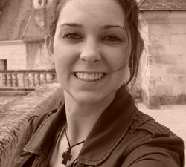
Ms. Allison Maureen Carmack
Allison Maureen is an Irish name.
Parents like both names, but my dad really wanted to name me Maureen.
My last name comes from the Irish last name “McCormick”

Slide 3
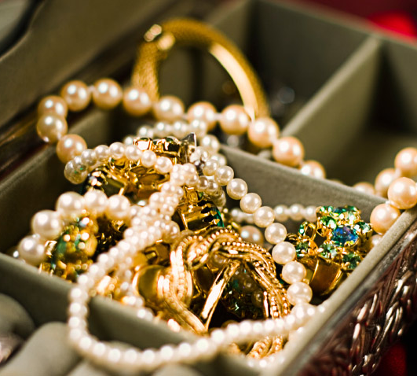
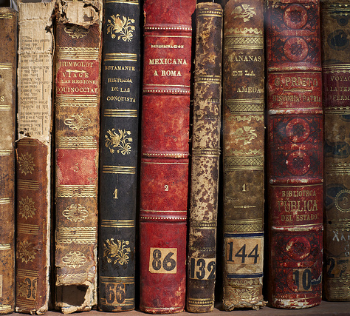
My Precious Belongings

Slide 4
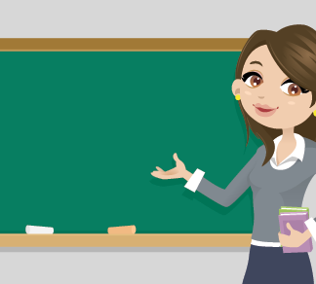
My Self-Identity
Teacher
Sister
Daughter
Friend
Middle Class
Traveler
Born and raised in Ann Arbor, Michigan
White/Caucasian
Student
Speak English and French

Slide 5
Family History
My Dad’s Side [Carmack]
My Mom’s Side [Doty]

Slide 6
Family Member’s Self-Identity: Melanie
My younger sister
Lives in San Francisco
Married
Works for Tesla
Business Student
Cancer survivor
Cat lover

Slide 7
Making Connections....
To Literature

Slide 8
Connection to Literature #1 “Legal Alien” by Pat Mora
“Sliding back and forth/between the fringes of both worlds/by smiling/by masking the discomfort/of being pre-judged/Bi-laterally” (Mora 473).
I relate to this poem because I have a degree in French, and I am able to communicate in two languages. Like the speaker, I am sometimes caught between two worlds.

Slide 9
Connection to Literature #2

Slide 10
Connection to Literature #3 Night by Elie Wiesel

Slide 11
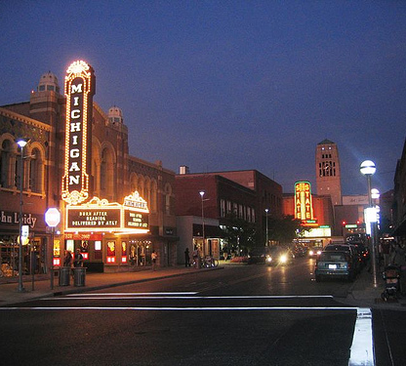
My Future...
Attend graduate school
Have a family
Continue to travel
Continue to teach
Maybe write a novel
Someday move back to Ann Arbor

Slide 12
Bibliography/Work Cited Page

