Slide 1
Student Sample Pop Culture Project
Unit 6: Self-Identity
English 9 Honors
Carmack
Bethel High School

Slide 2
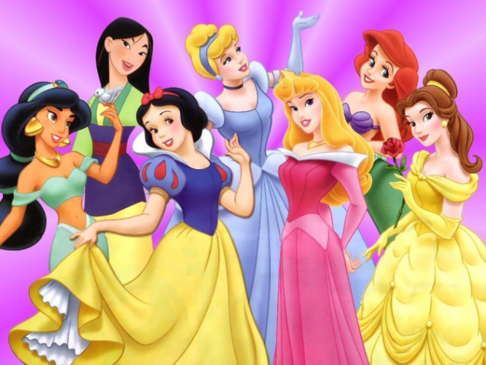
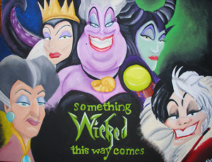
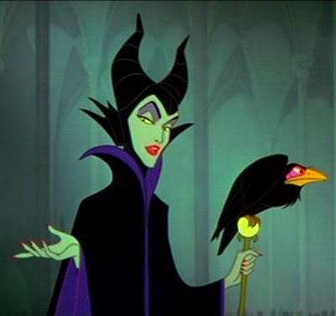
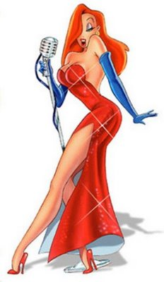
Issue: Women of Disney…Fantasy or Reality?
Presented by: Ms. Allison Carmack

Slide 3
Purpose
Women’s gender roles will be examined.
The following questions will be addressed:
-What kind of “female” images are being represented through Disney’s animated characters?
-Can one find “hidden messages” within Disney movies/products? If so, what are they?

Slide 4
Statics about the Disney Company
“Disney Consumer Products, eager to tap into such a market, fostered a partnership with Walmart in 2997 to sell such merchandise based on Hanna Montana, High School Musical, and other franchises and expected its tween retail business to reach $400 million in sales in 2008 (Giroux & Pollock 23).
“In 1995, more than 200 million people a year watched a Disney film or home video (Giroux & Pollock 19).
395 million watched a Disney TV show every week (Giroux & Pollock 19).
212 million listened or danced to Disney music, records, tapes, or compact discs (Giroux & Pollock 19).
More than 50 million people a year from all lands passed through the turnstiles of Disney theme parks (Giroux & Pollock 19).
Disney’s culture attracts the attention of mostly children (Giroux & Pollock 19).

Slide 5
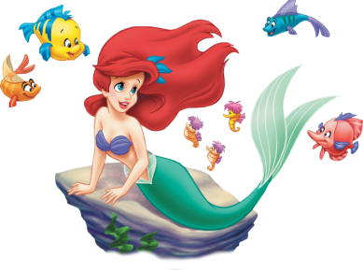
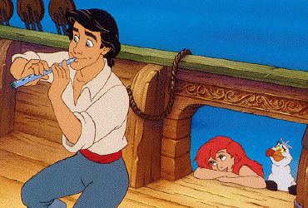
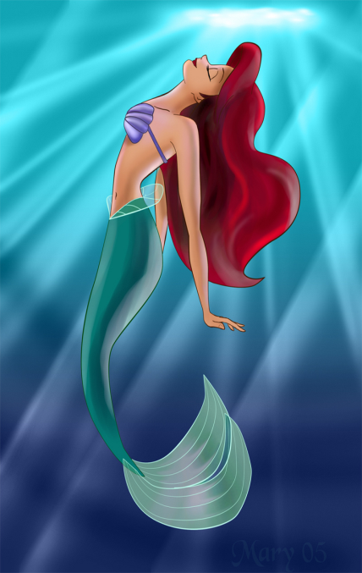
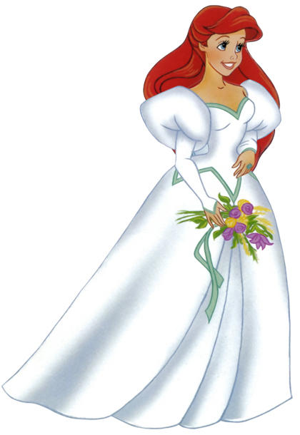
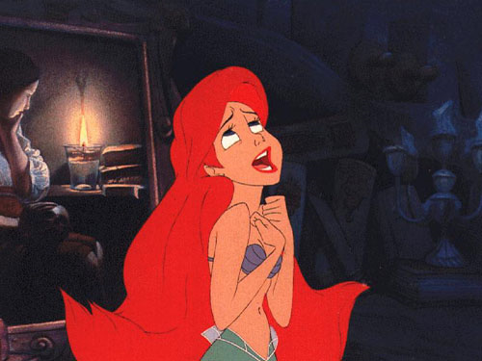
Example 1 The Little Mermaid: Ariel (1989)

Slide 6
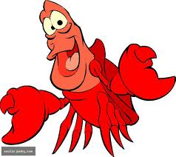
Ariel and her Sea World
“Undoubtedly, feminists have criticized The Little Mermaid’s Ariel because she seems to have little ambition beyond getting her prince” (Trites 1990).
Example: Ariel’s anthem “Part of your World.” Illustrates her desire to become a citizen and participate in the human public (178). This song uses words of mobility, “run,” “walk,” “dance.”
She faces the pain of having to conform to society when she visits Ursula.
Her body is literally transformed. She also has to choose between “voice” and “access” to the human culture. She can never have both.
Ariel’s voyage to the “real world” symbolizes women’s “access to the white male system” (Bell 177).
The Sea World symbolizes the invisible or mythic world; Eric’s white world symbolizes “cultural validity” (Bell 178).
Sebastian’s character illustrates many of the same characteristics that are present in people of color.
Eric and his friends dismiss the sea world as a myth/urban legend/”fairy tale.”

Slide 7
Is Ariel’s character hopeful?
She regains her voice after she has married Eric.
In the original fairy tale, Anderson kills off the mermaid because she “fails to earn the prince’s love” (180).
“Anderson offers women several paths towards self-realization, so the message to children is much more farsighted than Disney’s limited message that only through marriage can a woman be complete” (1990/91, 150).
However, it is important to remember that Anderson’s message is still limiting. Anderson’s little mermaid is still under the rule and control of God.
Ursula’s death is also symbolic:
Illustrates the death and silence of a strong, independent female.
Her image after death is of a voice, speaking subject who has been taught that gender is a performance.
Ariel does learns this lesson from Ursula.

Slide 8
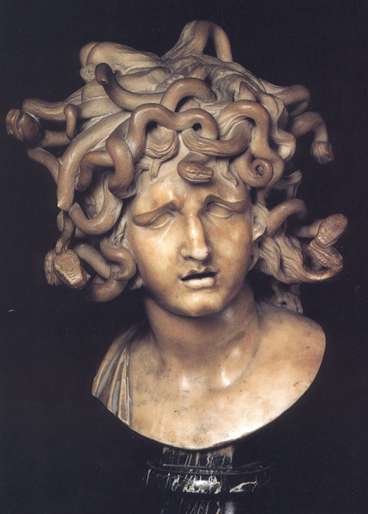
Ursula: The Inverted Medusa

Slide 9
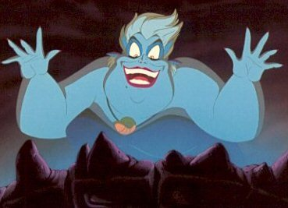
Ursula: The Inverted Medusa continued…
Ursula: The Monstrous Sea Witch
Disney’s pattern with female villains: “Any woman with power has to be represented as a castrating bitch” (181).
Ursula’s death at the end of the movie further silences and ignores women in power. In the white system, it is much easier to be silent than monstrous (181).
“Ursula teaches Ariel that performance and voice are manifestations and liberations of gender” (182).
http://www.youtube.com/watch?v=oDRmuK0ZPLI
Ursula’s image is literally the inverted image of Greek Mythology’s Medusa; ironic figure
Ursula’s is unlike any other female villain in the Walt Disney animated movies. She is a symbol of the “repressed” (181).
She is presented as a drag queen who transcends all previously established social gender boundaries; OR she’s the image of a strong, independent material figure.
Ursula is the only female who understands gender boundaries. Before she transforms Ariel, she warns her of what will have to happen if she wishes to be part of the human world. Once Ariel accepts, she transforms her body into an “acceptable” one.
Ariel’s voice is also taken by Ursula. This suggests that if women want to be accepted into white, male dominated societies, then they must physically transform themselves, and meet the established standards of white, male dominated societies. They also must realize that they will not have a voice in society. (When Ariel initially enters Eric’s world, she literally cannot speak.)
“YouTube Clip: “Poor Unfortunate Soul”

Slide 10
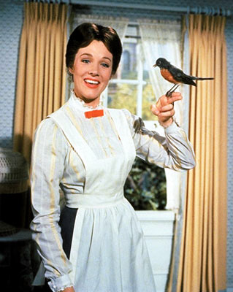
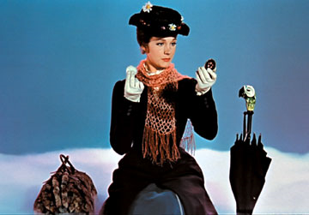
Example 2: Mary Poppins (1964)

Slide 11
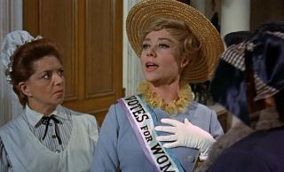
“Mary Poppins, practically perfect in every way.”
Mary Poppins: Nanny, spinster, and sexually neutral female.
She never challenges Mr. Bank’s position in the Bank household.
Feminist movement never addressed…is it used as a joke?
Mary Poppin’s role in the film is to remind George Banks of his place in society. He needs to be the head of the household so that the Victorian monarchy can be supported by the families of England.
By the end of the movie, George Banks gets all that he wanted…control of his misbehaved children, obedient wife, and promotion at work.
Marry Poppins: “Let’s Go Fly a Kite:”
http://www.youtube.com/watch?v=g89NxTTycxc

Slide 12
Are there exceptions?
Disney’s Mulan: (1998)
*She dresses up as a guy so she can enroll in the Chinese army.
*She does get married at the end of the movie.
*By the end of the film, her male companions recognize her as a strong and independent female.
*Questions gender roles within a minority group.

Slide 13
Jasmine? (1992)
She plays the “independent and self-reliant female.”
Refuses to marry through out the majority of the movie.
By the end of the movie, she gives in to Aladdin's marriage proposal.
Good try Jasmine!

Slide 14
Connection to Literature #1: Animal Farm
“Going back, the others found that she had remained behind the best bedroom. She had taken a piece of blue ribbon from Mrs. Jones’s dressing-table and was holding it against her shoulder and admiring herself in the glass in a very foolish manner” (Orwell 19).
Fictional, female characters are often portrayed as individuals who are consumed by vanity.
Animal Farm and the Little Mermaid portray Mollie and Ariel as females who are overly concerned about their physical appearance.

Slide 15
Connection to Literature #2: Thor Gains his Hammer
Like the Little Mermaid, Thor Gains his Hammer is also a story about an individual who must temporarily alter his appearance in order to obtain what he wants.
Something to think about: Do both characters benefit from this physical transformation?
Thor dresses like a bride in order to gain his hammer back from the Ice Giants.

Slide 16
Connection to Literature #3: Romeo and Juliet
Juliet and Ariel are willing to do whatever it takes to escape previous arrangements made by their fathers.
Juliet and Ariel are made to believe they cannot control their futures successfully.
Ariel does not commit suicide, but her story illustrates her taking drastic measures in order to be with her romantic interest.

Slide 17
How can we fix the problem?
Yes, I believe this problem can be fixed.
Our culture needs to continue to produce unbiased characters within television and movies.
Children should spend less time watching television.

Slide 18
Work Cited Page/ Bibliography
Bell, Elizabeth, Hass, Lynda, & Sells, Laura. (1995). From mouse to mermaid. Indiana University Press.
Giroux, Henry A. & Pollock, Grace. (2010). The mouse that roared. Roman & Littlefield Publishers, Inc.
Orwell, George. Animal Farm. Austin: Holt, Rinehart and Winston, 1996. Print.
Thor Gains His Hammer.
Shakespeare. Romeo and Juliet.
All pictures retrieved from: http://www.google.com/imghp?hl=en&tab=wi
Video clips retrieved from: http://www.youtube.com and http://www.comedycentral.com/
http://www.disneymovieslist.com/disney-movies.asp

